Slide 1
How does a person’s socioeconomic background affect their employment opportunities and wages?
By Davian

Slide 2
Datasets
AverageMeanMonthlyNominalEarningsPerEmployeeBySexQuarterly.csv- https://beta.data.gov.sg/collections/643/view
wage_01_sex2_annual.csv - https://beta.data.gov.sg/collections/671/datasets/d_a0a2ee53ade228095be6b86cf1eb43df/view
UnemployedResidentsAged15YearsandOverbyHighestQualificationAttainedAgeAndSex.csv - https://beta.data.gov.sg/collections/1922/view
OverallUnemploymentRateAnnual.csv - https://beta.data.gov.sg/collections/2119/datasets/d_e3598914c86699a9a36e68190f78c59a/view
BasicWageChangeTotal.csv - https://beta.data.gov.sg/collections/662/datasets/d_a73c27669241db5833f5cd23057141c5/view
TotalWageChangeTotal.csv - https://beta.data.gov.sg/collections/676/datasets/d_ae92f125ca6bf7e3bba260c137a68c79/view
ResidentLabourForceAged15YearsandOverbyLabourForceStatusAgeAndSex.csv - https://beta.data.gov.sg/collections/1921/view

Slide 3
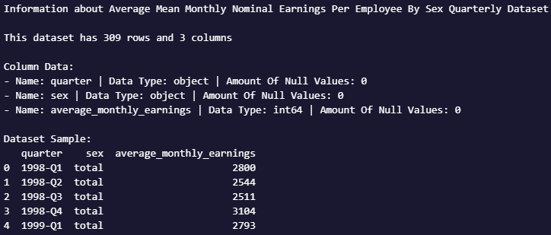
Average Mean Monthly Nominal Earnings Per Employee By Sex Quarterly Dataset Info
This dataset contains the mean wages by sex.
It comprises basic wages, overtime pay, commissions, allowances and bonuses but exclude employer CPF contributions.

Slide 4
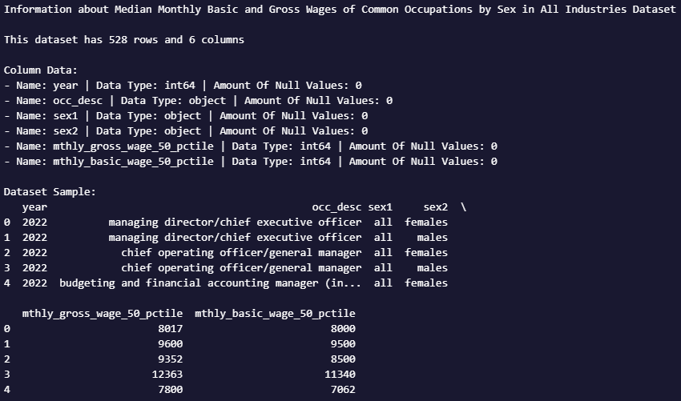
wage_01_sex2_annual Dataset Info
This dataset contains Median Monthly Basic and Gross Wages of Common Occupations by Sex in All Industries

Slide 5
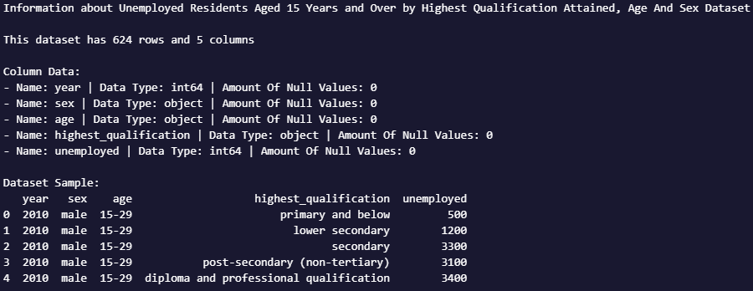
Unemployed Residents Aged 15 Years and Over by Highest Qualification Attained Age And Sex Dataset Info
This dataset contains unemployment information for those aged 15 years and above

Slide 6
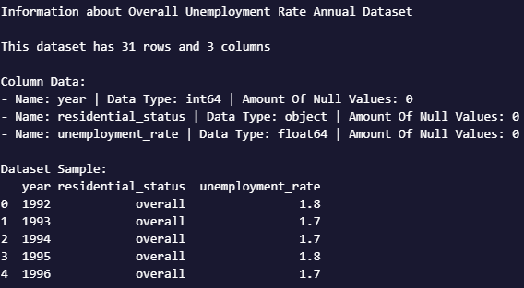
Overall Unemployment Rate Annual Dataset Info
This dataset contains the averages of the non-seasonally adjusted unemployment figures obtained at quarterly intervals.

Slide 7
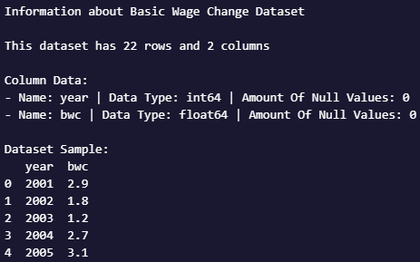
Basic Wage Change Dataset Info
This dataset contains yearly changes in percentages of basic wages
Basic wages refers to the basic pay before deduction of employee CPF contributions and personal income tax. It excludes employer CPF contributions, bonuses, overtime payments, commissions, allowances.

Slide 8
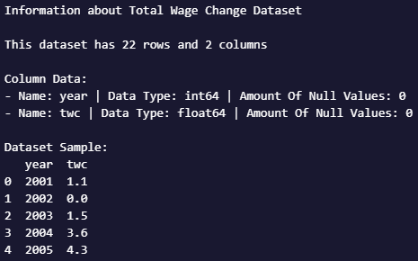
Total Wage Change Dataset Info
This dataset contains yearly changes in percentages of total wages
Total Wages refers to the sum of basic wages and bonuses.

Slide 9
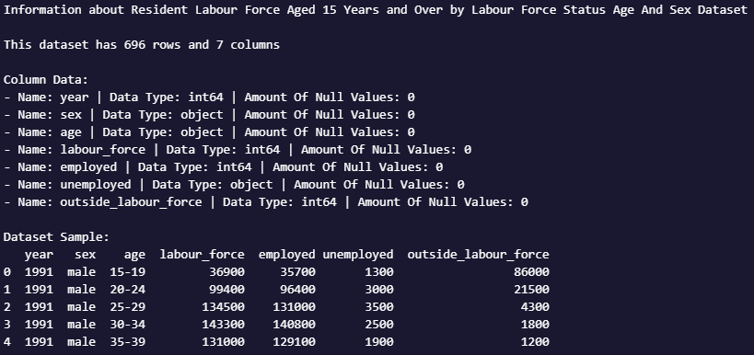
Resident Labour Force Aged 15 Years and Over by Labour Force Status Age And Sex Dataset Info
This dataset contains information for the resident labour force

Slide 10
Does a person's gender affect the wages they get?
Part 1.1

Slide 11
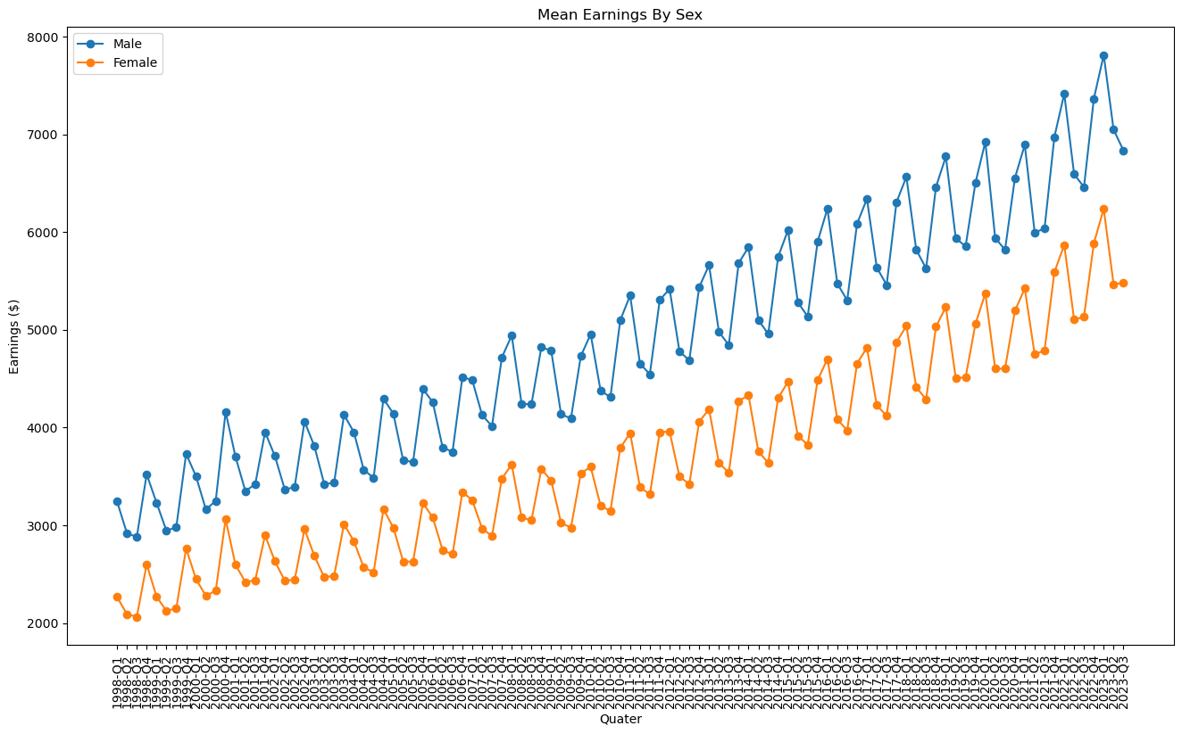
Mean Earnings By Sex

Slide 12
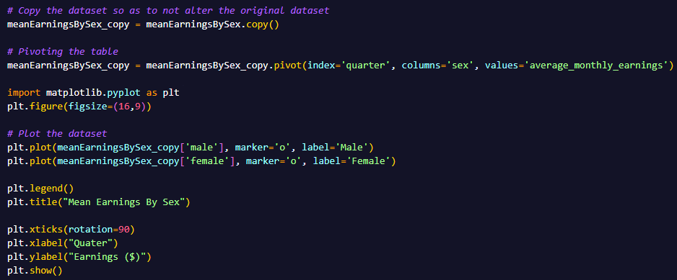
Mean Earnings By Sex – Pre-visualization Process
The dataframe was pivoted and the index is the quarter, sex as the column and average_monthly_earnings as the value.
After which, Matplotlib was used to visualise the data into a line graph.

Slide 13
Average Temperature Trends In A Year – Analysis
We can see that male workers earn a higher wage on average compared to their female counterparts. We can also see that the average earnings for both genders are on an increasing trend. We can also see that the mean salary usually rise and fall around Quarter 4 and Quarter 1.
One possible explanation for this fluctuation is that bonuses are usually given out at the end or at the start of the year, therefore and increase in the mean salary during these periods of the year is expected.

Slide 14
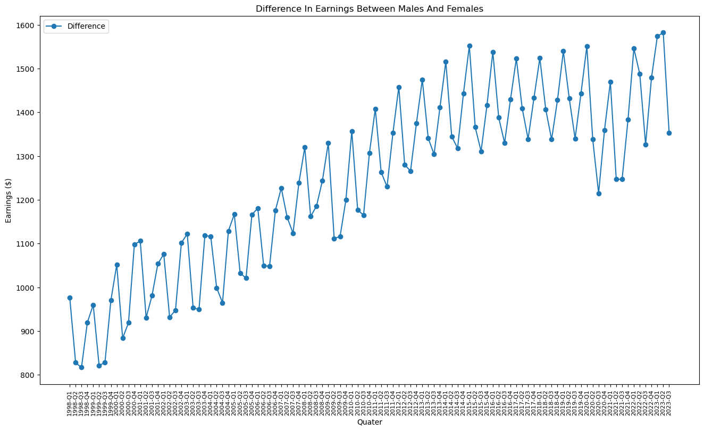
Difference In Earnings Between Males And Females

Slide 15
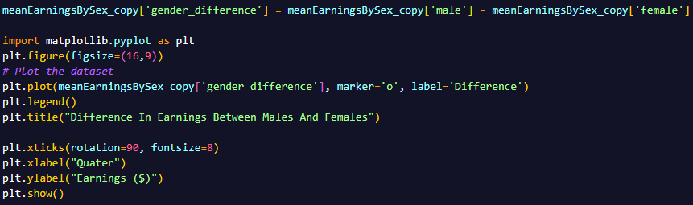
Difference In Earnings Between Males And Females – Pre-visualization Process
The difference in wages between males and females was calculated by subtracting the male column with the female column and assigning it to a new column named gender_difference
After which, Matplotlib was used to visualise the data into a line graph.

Slide 16
Difference In Earnings Between Males And Females – Analysis
We can see that the difference in the wage gap between males and females was initially on an increasing trend from 1988 to about 2014 but stopped and remained stable there from 2014 till 2023
The difference in pay between both genders in recent years are between $1.2k to $1.6k

Slide 17
Breakdown By Industry
Part 1.2

Slide 18
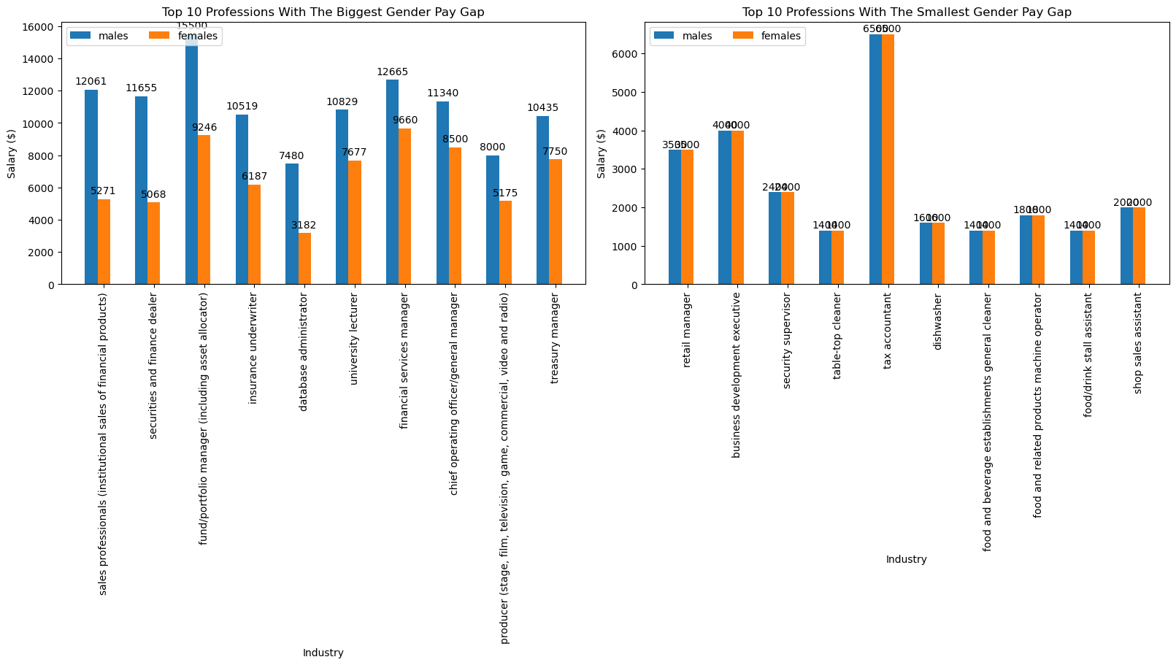
Gender Pay Gap By Industry

Slide 19
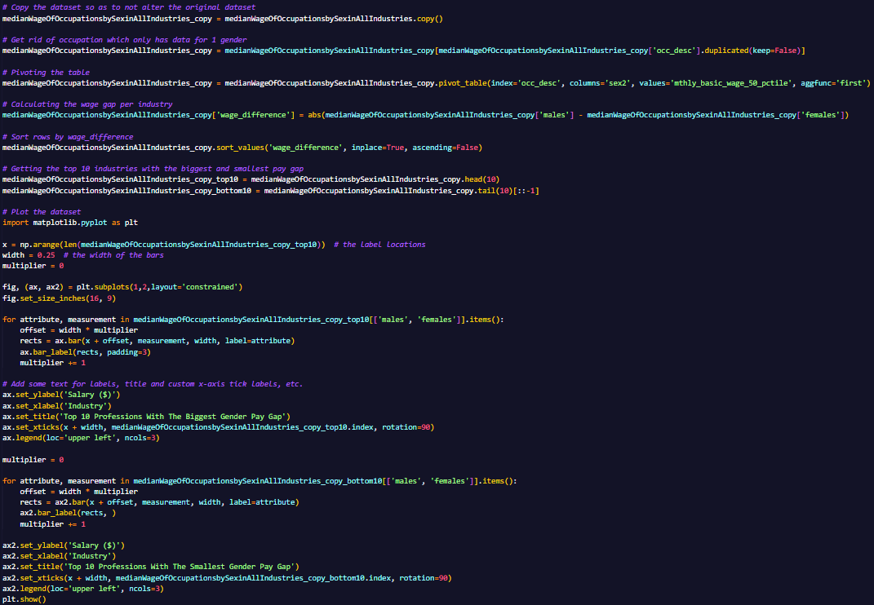
Gender Pay Gap By Industry– Pre-visualization Process
Pandas was used to get rid of occupation with only 1 gender data, pivot the table and calculate the wage gap for each occupation. After that, sort rows by wage_difference and getting the top and bottom 10 gender wage gap.
Matplotlib was then used to visualise the data as a grouped bar chart.

Slide 20
Gender Pay Gap By Industry – Analysis
We can see that the industry with the highest gender pay gap are mostly finance related and are usually high paying jobs like sales professionals, fund/portfolio manager and the likes.
Industries with higher gender pay gap are usually considered high-level jobs and have higher pay. On the other end, industries with the smallest gender pay gap are those usually considered to be low-level like table-top cleaner, security supervisor and dishwasher.

Slide 21
Unemployment By Highest Qualification Attained
Part 1.3

Slide 22
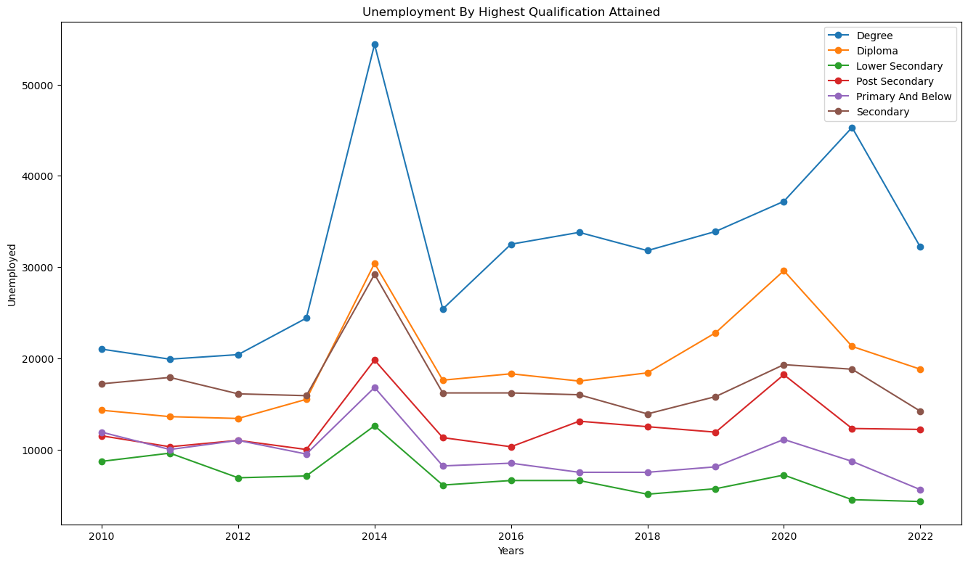
Unemployment By Highest Qualification Attained

Slide 23
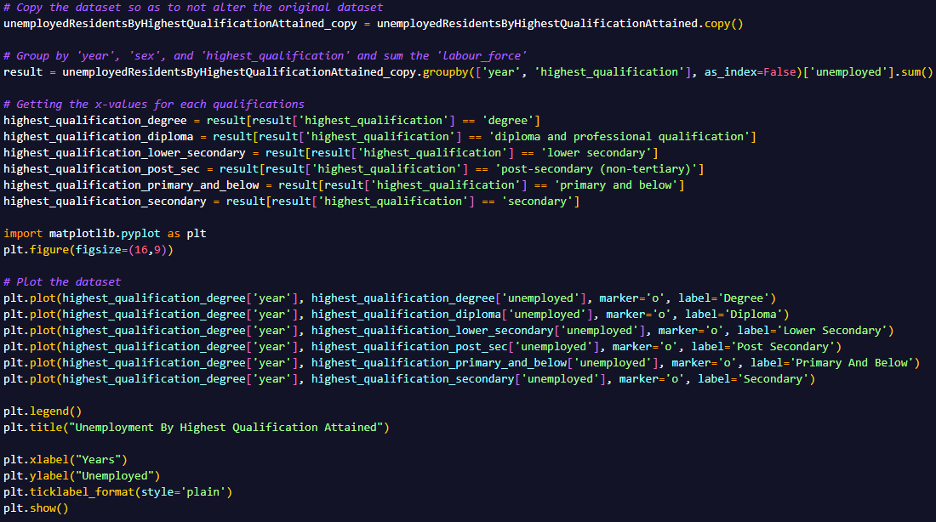
Unemployment By Highest Qualification Attained - Pre-visualization Process
The dataset was grouped by year and highest qualification
Then we subset the rows according to the qualification
Matplotlib was used to plot the line graph

Slide 24
Unemployment By Highest Qualification Attained - Analysis
We can see that the unemployment rate for degree and diploma holders have been on an increasing trend since 2010 while other qualifications have remained stable or even decreased.
This is unexpected as we would expect that degree or diploma holders would have a lower unemployment rate due to their high qualifications.
One possible reason for this would be that there is an oversaturation of degree and diploma holders.

Slide 25
How does age affect employment opportunities?
Part 2

Slide 26
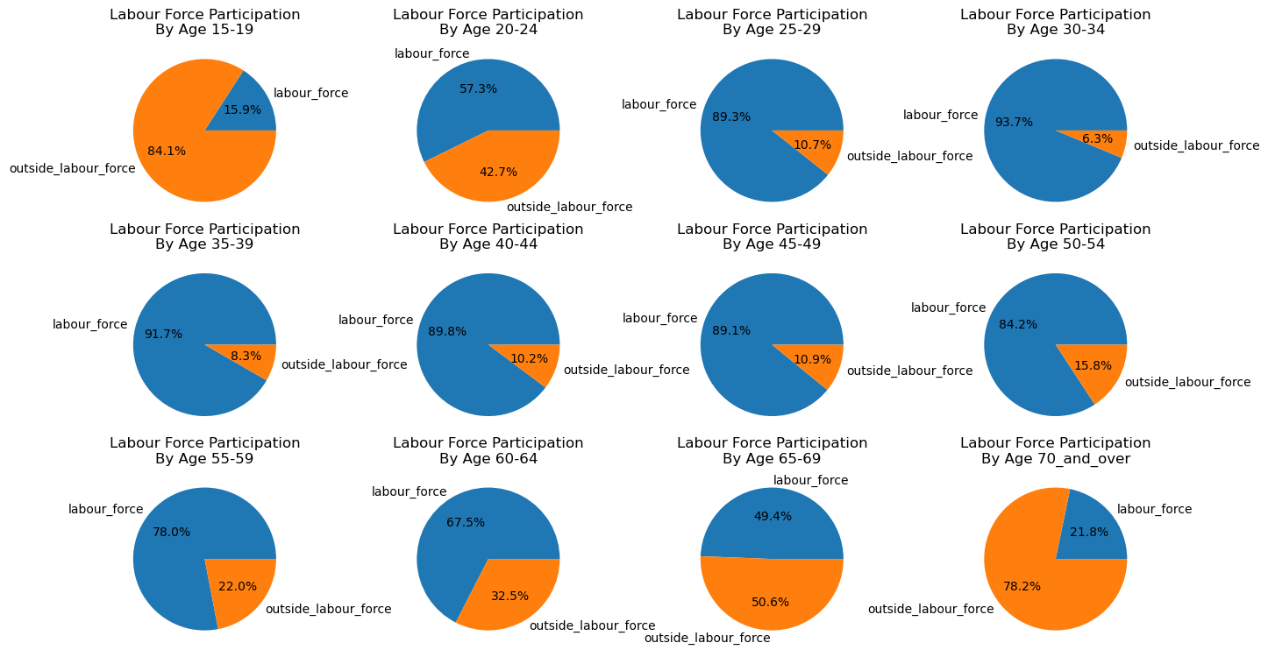
Proportions of labour force by age group

Slide 27
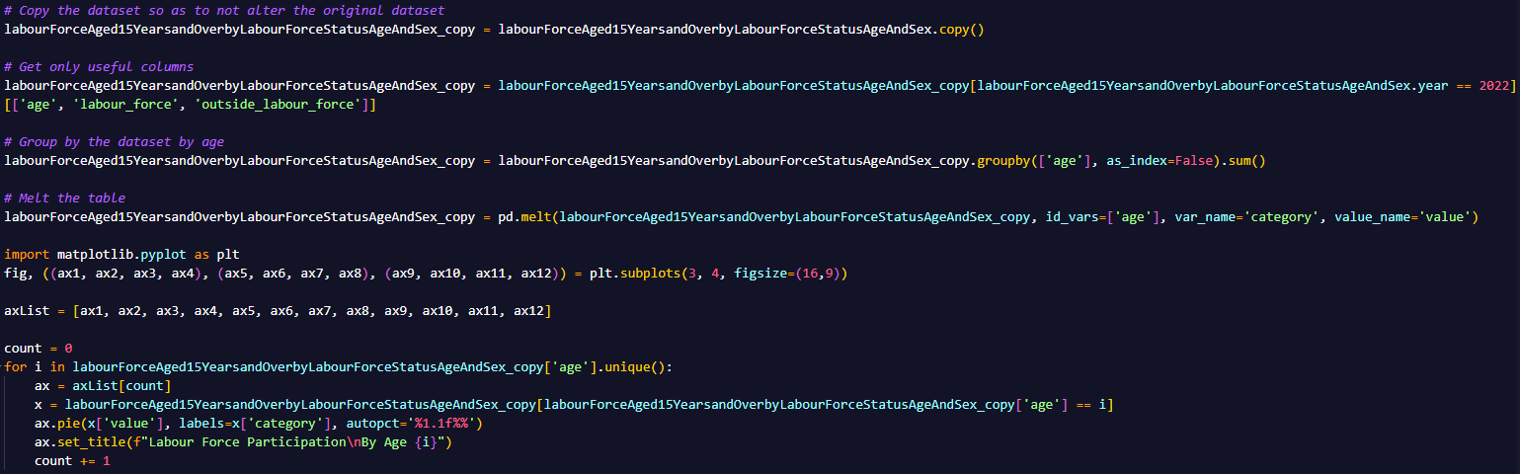
Proportions of labour force by age group - Pre-visualization Process
We first subset to get the year and then select only the columns we need. After that, we group by the age and sum up the values. After which we melt the table. We then use matplotlib to display the data as pie charts.

Slide 28
Proportions of labour force by age group - Analysis
As we can see from the pie charts above, only a minority, 15.9% of youths aged 15 to 19 are working. This is expected as most of the youth in that age range are currently still studying full time.
The labour force aged 25-29 shows the completely opposite result with the minority, 10.7% of that age group outside of the work force.
From ages 25-29 onwards, the proportions of labour force participations remains roughly the same until the ages 50-54 where the proportion of those outside the work force starts to grow. This is expected as from that age group onwards, people would start to retire.
The biggest jump in outside work force proportion is from age 60-64 to age 65-69 from 32.5& to 50.6%. This is expected as the retiring age in Singapore is 63 years old. Only 21.8% of those 70 and over are still working.

Slide 29
How does unemployment rate affect wages?
Part 3

Slide 30
How does unemployment rate affect total wage changes?
Part 3.1

Slide 31
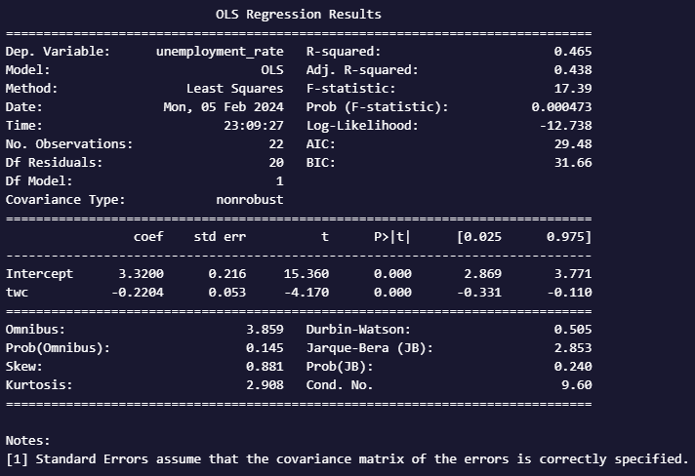
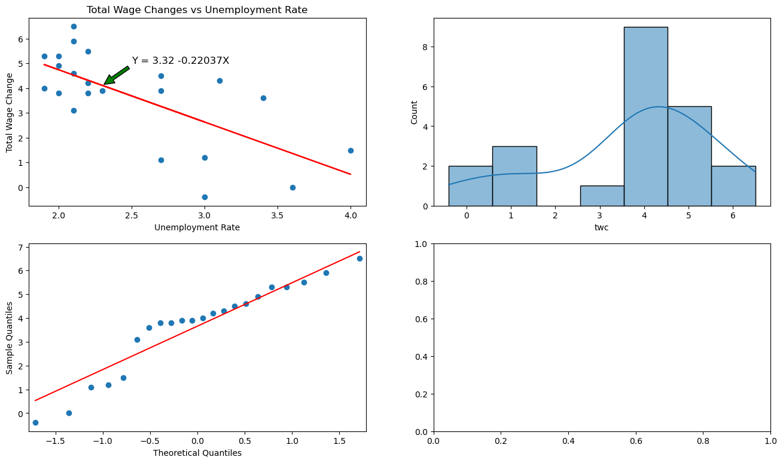
Total Wage Changes vs Unemployment Rate

Slide 32
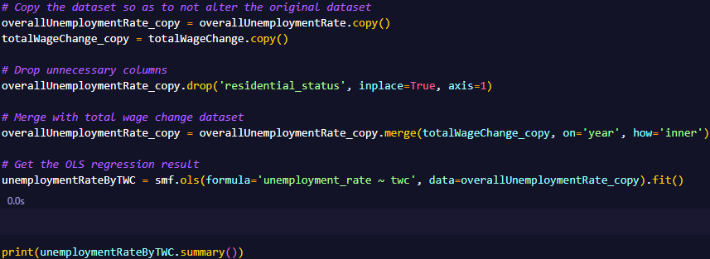
Total Wage Changes vs Unemployment Rate - Pre-visualization Process
Dropped unnecessary columns from the unemployment dataset
Merged the unemployment dataset with total wage change
After which, I used Statsmodel to get the OLS regression result and summary

Slide 33
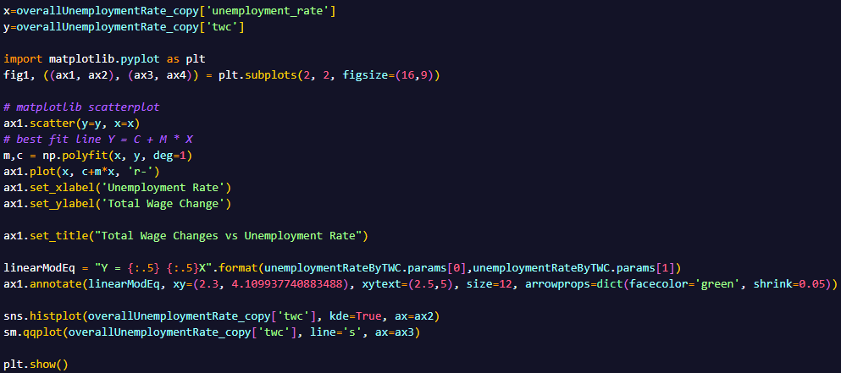
Total Wage Changes vs Unemployment Rate - Pre-visualization Process
Assign variable x to the unemployment_rate and the y to the total wage change.
Plot the scatter graph and best fit line
After which, annotate the best fit line with the line equation
Plot the histogram and Q-Q plot

Slide 34
Total Wage Changes vs Unemployment Rate - Analysis
Total wage change includes bonuses along with the basic pay.
With a squared value of 0.465, we can see that there is a moderate negative relationship between the total wage change and unemployment rate. This goes to show that as the unemployment rate rises, wages rises at a slower pace and lesser bonuses is given out, which is to be expected.
For every one percent increase in unemployment rate, the total wage change decreases by 0.22%.
The distribution is not close to normal as can be seen in the histogram and Q-Q plot. Which can lead to the model not fitting well to the dataset

Slide 35
How does unemployment rate affect basic wage changes?
Part 3.2

Slide 36
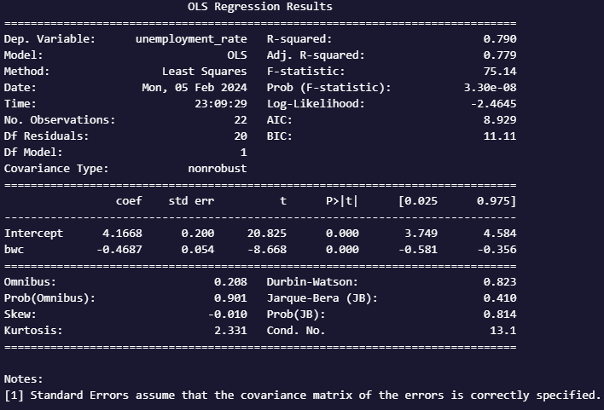
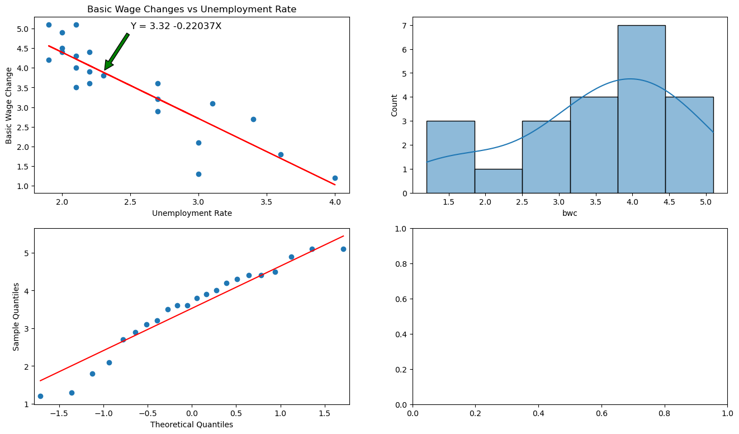
Basic Wage Changes vs Unemployment Rate

Slide 37
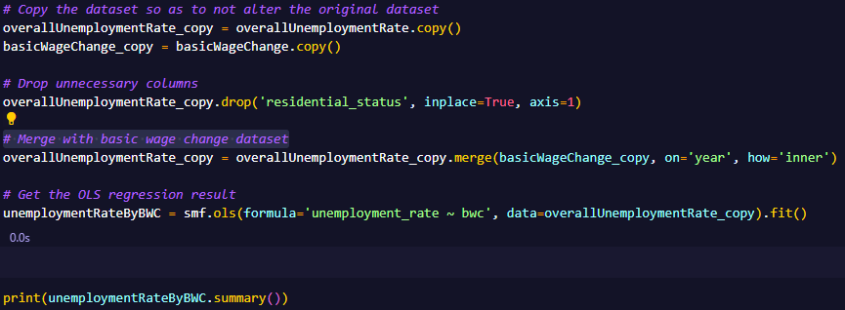
Basic Wage Changes vs Unemployment Rate - Pre-visualization Process
Dropped unnecessary columns from the unemployment dataset
Merged the unemployment dataset with basic wage change
After which, I used Statsmodel to get the OLS regression result and summary

Slide 38
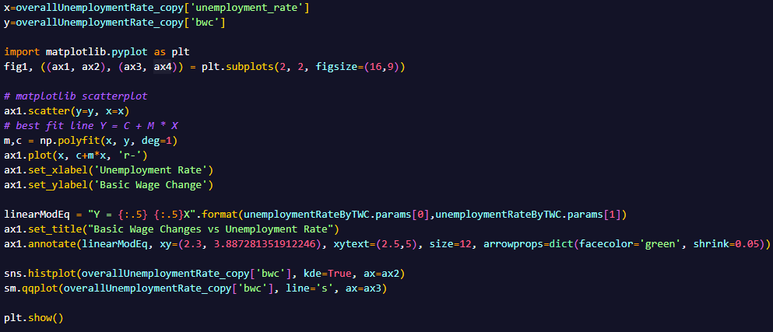
Basic Wage Changes vs Unemployment Rate - Pre-visualization Process
Assign variable x to the unemployment_rate and the y to the basic wage change.
Plot the scatter graph and best fit line
After which, annotate the best fit line with the line equation
Plot the histogram and Q-Q plot

Slide 39
Basic Wage Changes vs Unemployment Rate - Analysis
With an r-sqaured value of 0.79, we can see that there is a strong negative relationship between the basic wage change and unemployment rate.
For every one percent increase in unemployment rate, the basic wage change decreases by 0.22%.
This goes to show that as the unemployment rate rises, wages rises at a slower pace which is to be expected.
The distribution is not close to normal as can be seen in the histogram and Q-Q plot. Which can lead to the model not fitting well to the dataset.

Slide 40
In Conclusion
From our insights, we can conclude that there is a gender pay gap between males and female with males earning more than $1000 than females on average.
The industry you join and type of job you work determines whether you are more likely to be paid more or less than co-workers of the opposite gender.
Holding a degree or diploma does not guarantee you employment as degree and diploma holders have a higher proportion of unemployment.
As unemployment rates increase, basic and total salary increases at a slower pace.

Slide 41
Thank you!
Any questions?

